Slide 1

A crash introduction to your Linux
The Shell
Files
Permissions
1
A crash intro: the shell, permissions and files

Slide 2
Where do you type stuff in Linux? The Shell.
2
A crash intro: the shell, permissions and files

Slide 3
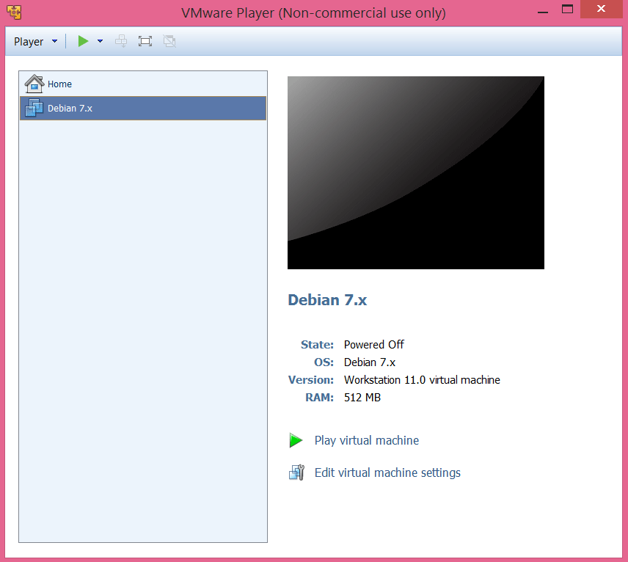
3
A crash intro: the shell, permissions and files

Slide 4
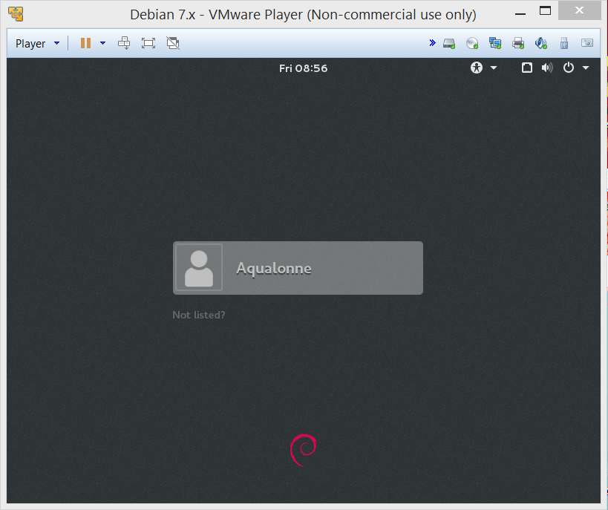
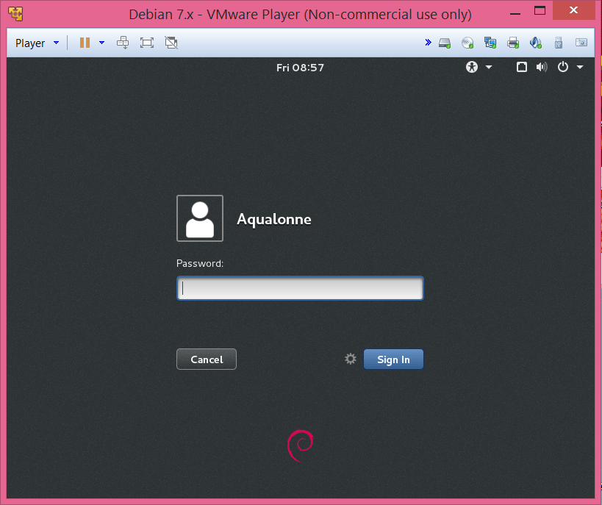
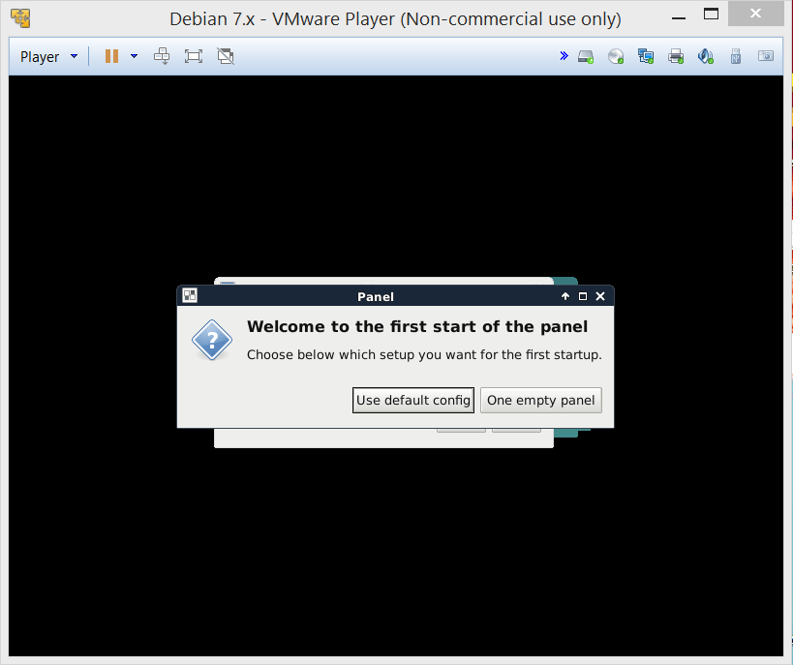
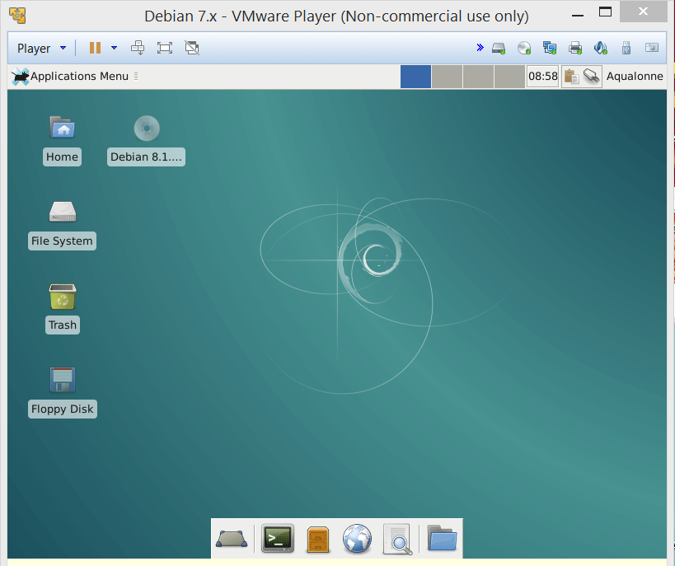
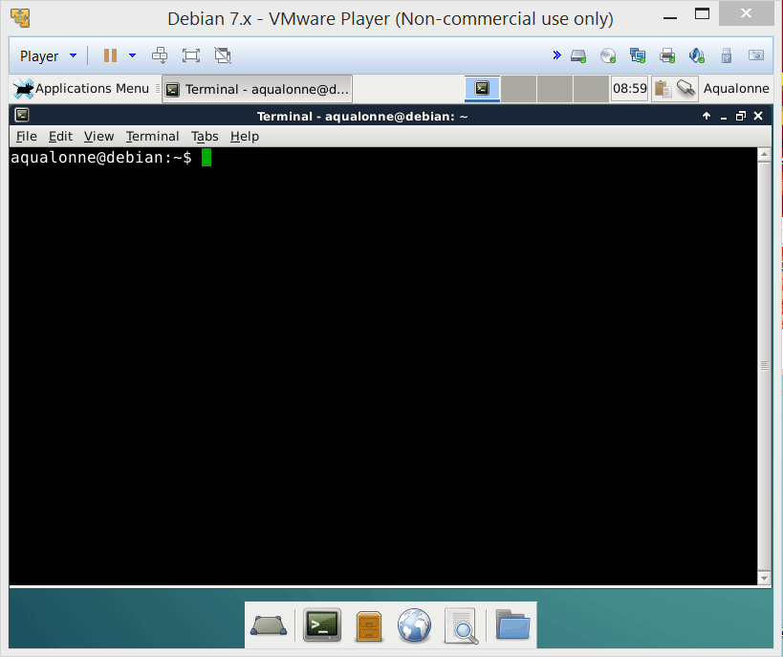
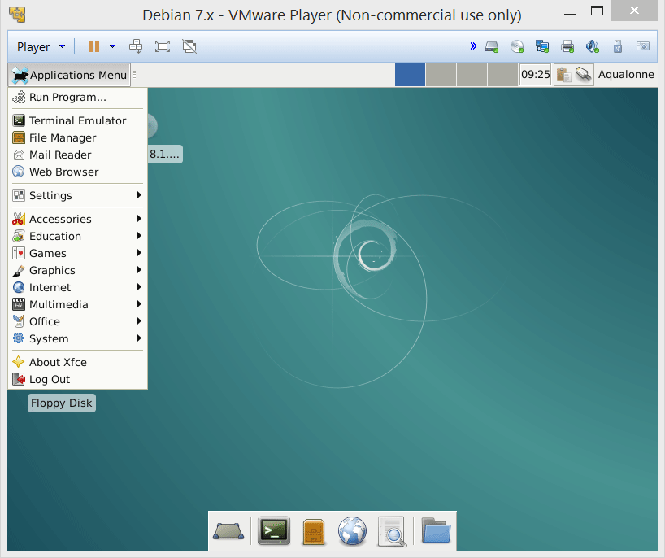
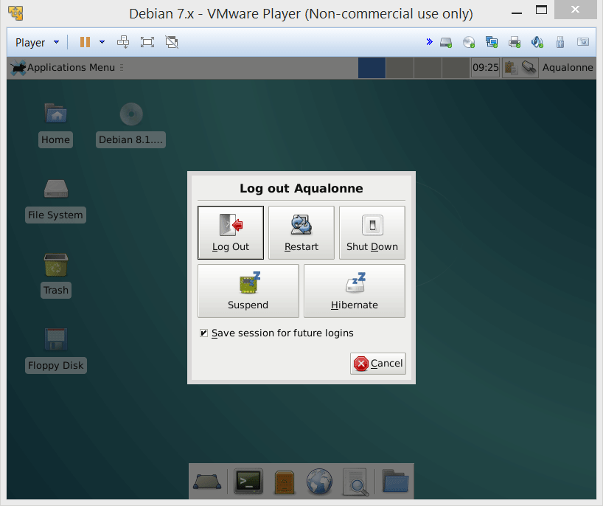
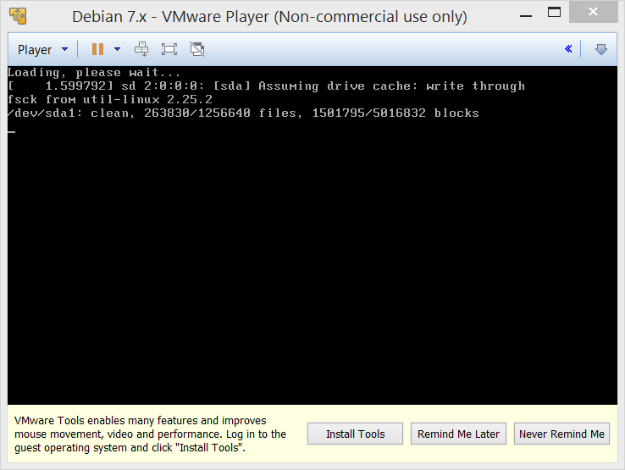
The Shell is a user interface to let you access the services of the operating system. It typically provides a command-line interface.
This is how you get to the Shell
4
A crash intro: the shell, permissions and files

Slide 5
UNIX Shell
traditional user interface
= the “command line”
Features:
Interpret and execute commands
Command history and editing
Command scripting
Job control
5
A crash intro: the shell, permissions and files

Slide 6

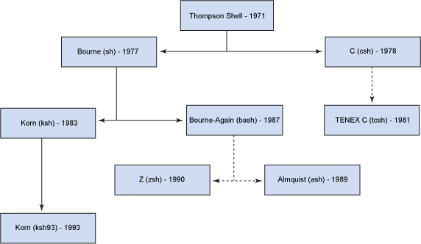

UNIX Shells
There are different possible Unix Shells. The one we use is Bash.
If you want to know more about the shells, just have a look at Unix Shell on Wikipedia!
6
A crash intro: the shell, permissions and files

Slide 7
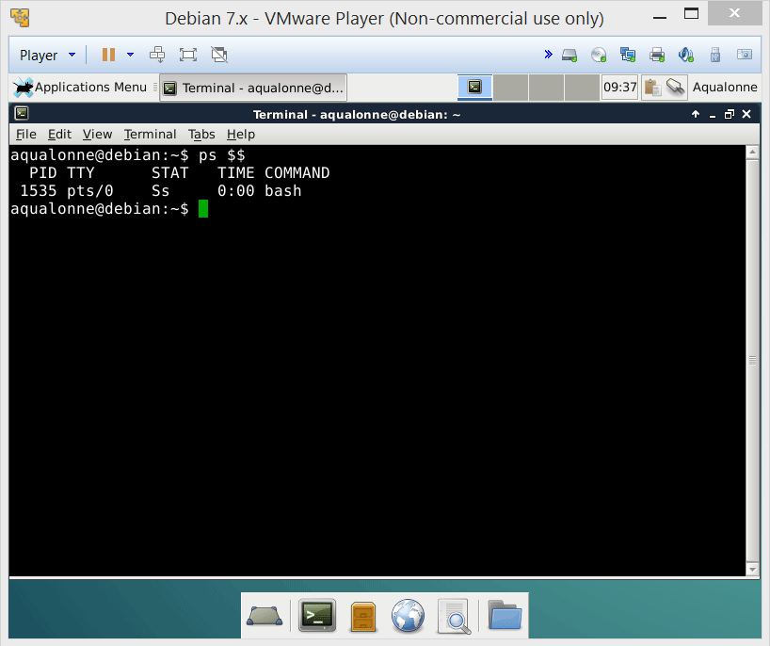
UNIX Shells
To know what Shell you are using, type the command:
ps $$
7
A crash intro: the shell, permissions and files

Slide 8
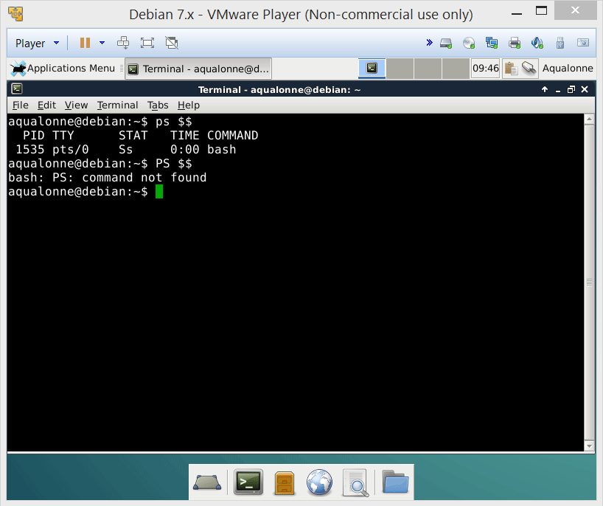
UNIX Shells
Unix is case-sensitive!
8
A crash intro: the shell, permissions and files

Slide 9
UNIX Shells
Argument
Command name
Command prompt
9
A crash intro: the shell, permissions and files

Slide 10
UNIX Shells
$ command [-options] [arguments]
Command name
Command modifier; usually one character preceded by + or - sign
Arguments can be:
1. More information
2. Object identifiers
3. Names of files
Command prompt
Optional
Optional
$ ps $$
$ ls -als
$ ps -A $$
$ clear
Examples:
Clears the screen. Very useful!
10
A crash intro: the shell, permissions and files

Slide 11

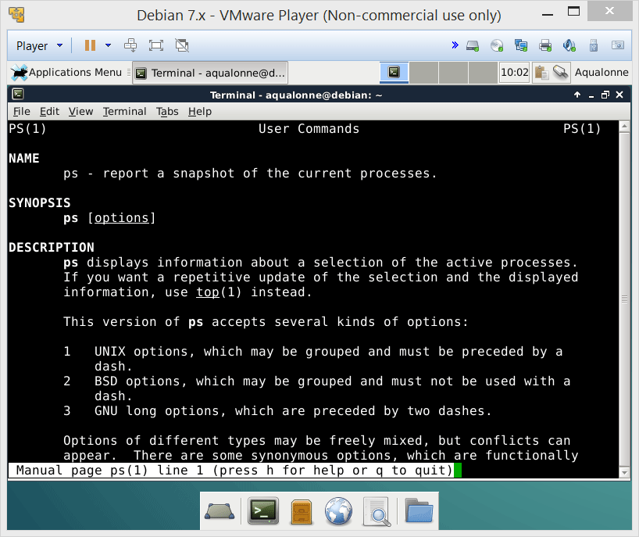
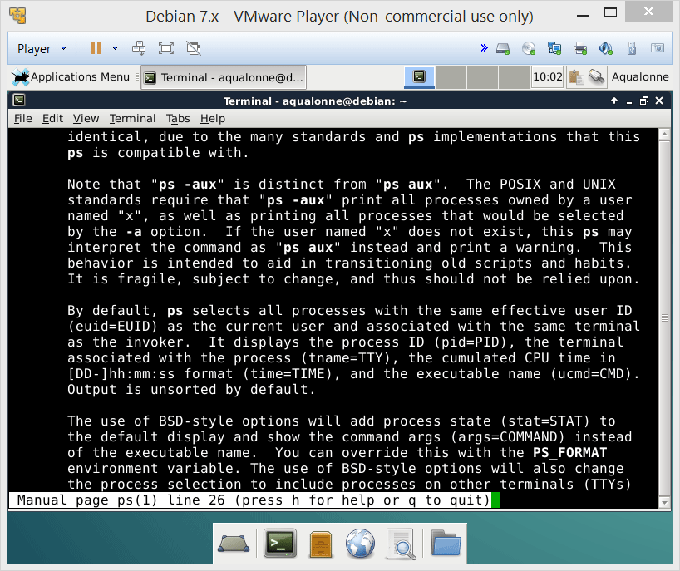
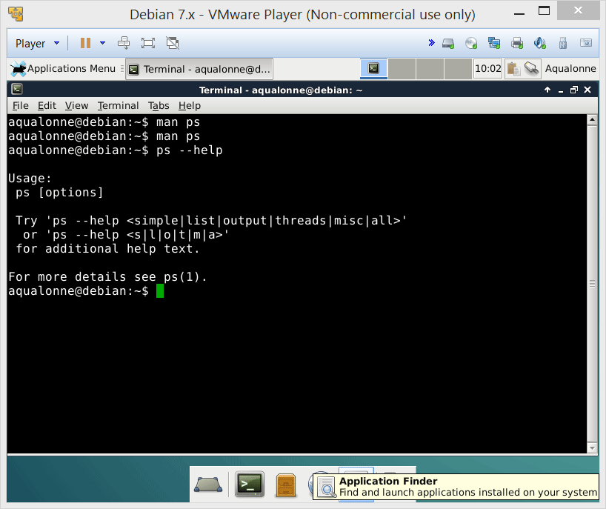

UNIX Shells
To read the manual for a command, use:
man command
To get a short help, use
command --help
For super short help...
whatis command
11
A crash intro: the shell, permissions and files

Slide 12
UNIX Shells
Key Pressed | Result
Backspace, Ctrl-h | Back up & erase last character
Ctrl-c | Terminates the current command (watch out for Ctrl-z: suspend command)
Ctrl-s | Stops scrolling of output on screen (Ctrl-q to resume/start scrolling)
Ctrl-w | Delete previous word on command line (from cursor back)
Ctrl-u | Erases/deletes entire command line
12
A crash intro: the shell, permissions and files

Slide 13
UNIX Shells
Key Pressed | Result
Cntl-a | Go to beginning of line
Ctrl-e | Go to end of line
Esc-f | Go forward one word
Esc-b | Go back one word
Esc-d | Delete word (from cursor to end of word)
Cntl-d | Delete character at cursor
Cntl-k | Delete from cursor to end of line
13
A crash intro: the shell, permissions and files

Slide 14
The UNIX file system
14
A crash intro: the shell, permissions and files

Slide 15
The UNIX file system
hierarchical organization of files
contains directories and files
basic commands to list and manipulate files
independent of physical file system organization
always single tree
typical Unix file system types
ext3 (formerly ext2)
reiserfs
vfat
ntfs (now read & write)
15
A crash intro: the shell, permissions and files

Slide 16

The UNIX file system
Home directory for system administrator
root (/)
Binaries for essential commands
bin
home
boot
dev
System configuration
etc
var
lib
User files appear in either one, depending on the distribution
media
X11
opt
mnt
opt
Removable media e.g. USB
proc
usr
root
sbin
If you want to know what each folder is for... Just have a look at Unix filesystem on Wikipedia!
srv
tmp
lib
bin
include
16
A crash intro: the shell, permissions and files

Slide 17

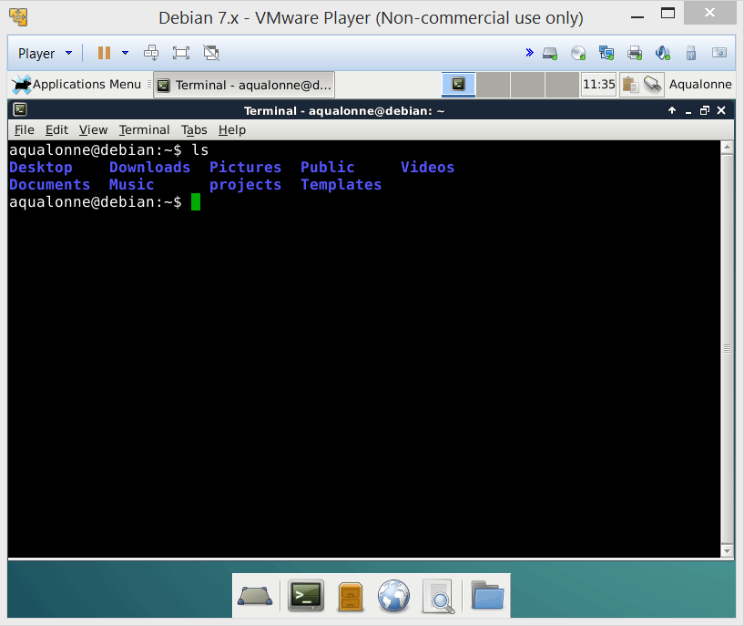
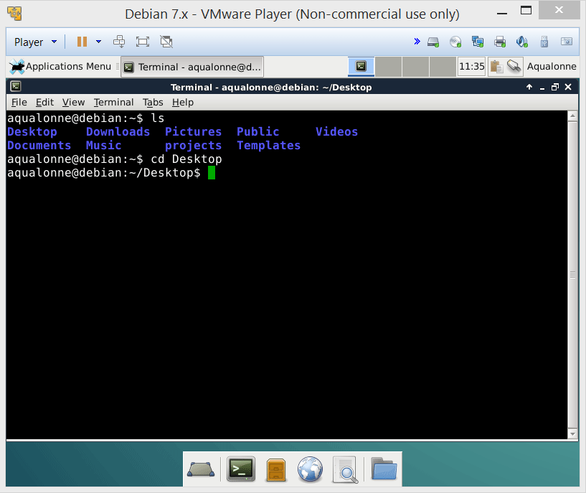
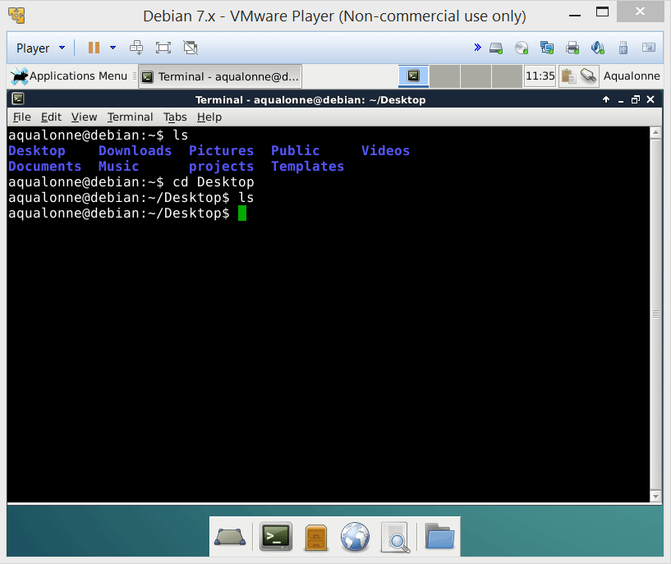
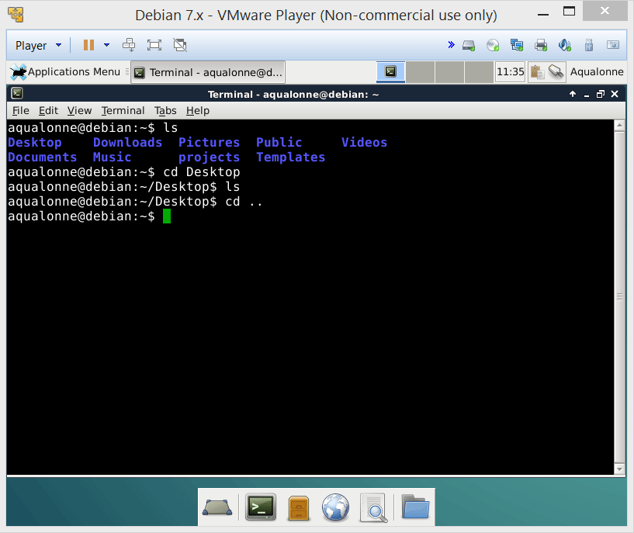
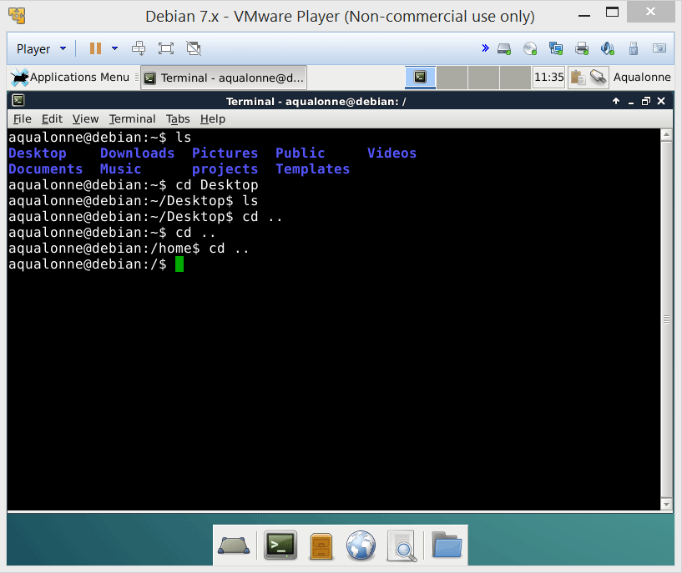
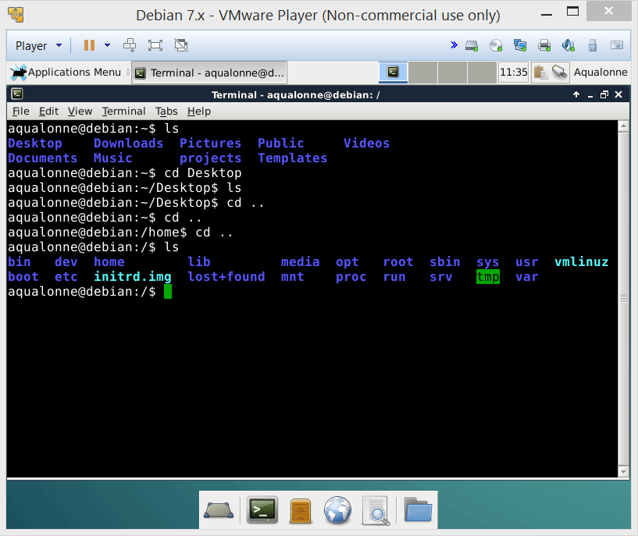
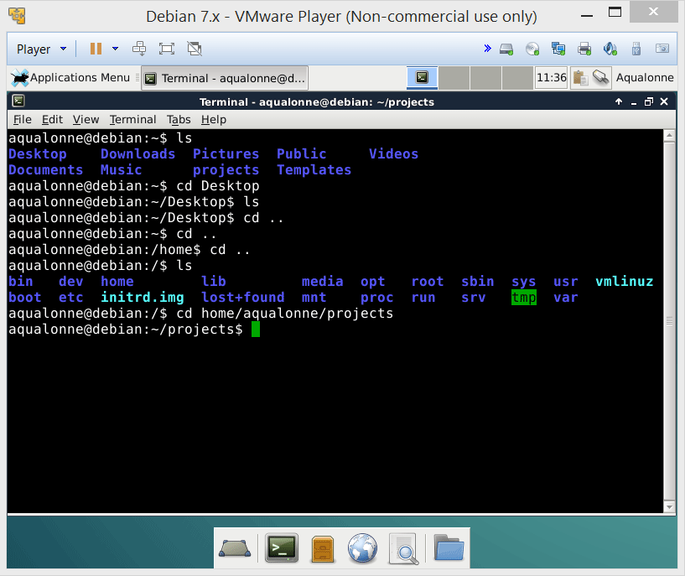

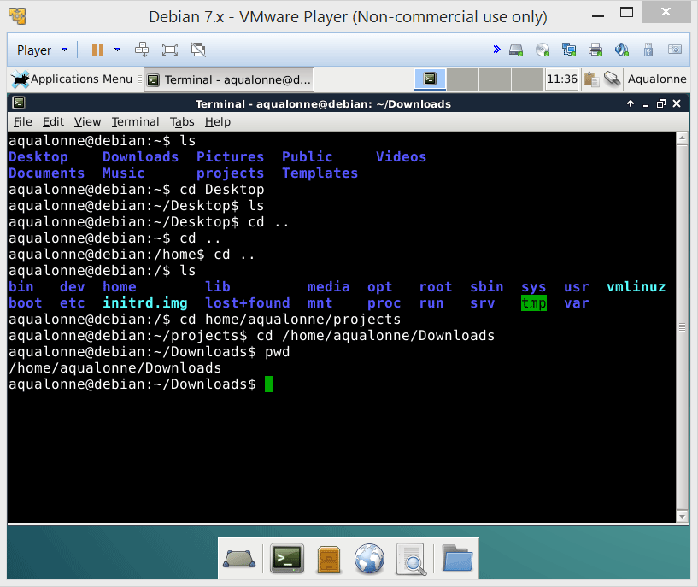
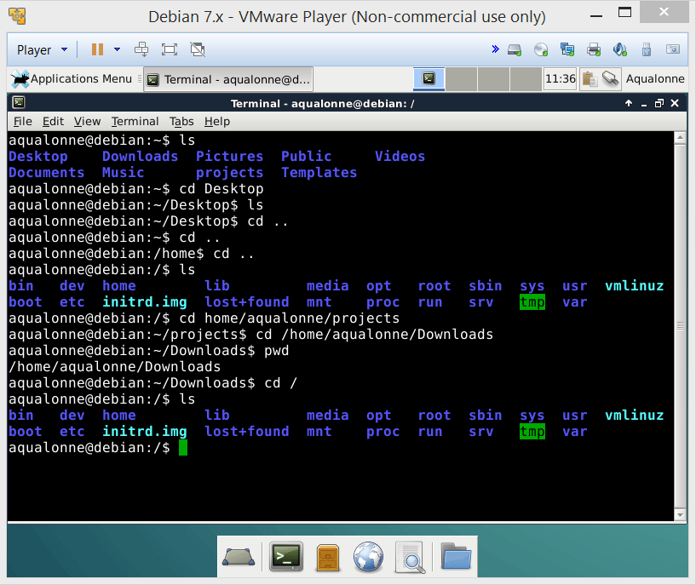
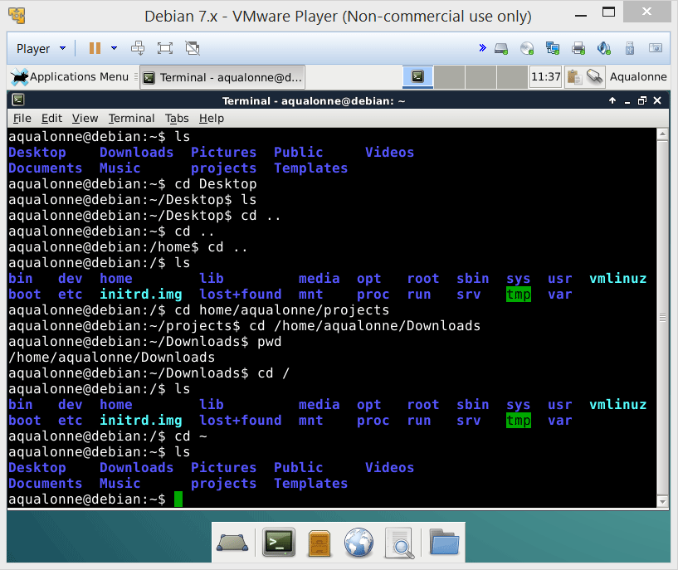
The UNIX file system
17
A crash intro: the shell, permissions and files

Slide 18
The UNIX file system
ls
Show what’s in a directory
pwd
Show where we are
cd path
Go somewhere
18
A crash intro: the shell, permissions and files

Slide 19
The UNIX file system
/
Root directory (top in any UNIX structure)
~
Home directory, owned by a user. It’s where you start when you log in as user.
..
Parent directory
.
Current directory
19
A crash intro: the shell, permissions and files

Slide 20
The UNIX file system
A path is a list of directories separated by /
A path can be:
Absolute
Starts from the root, so begins with /
Relative
Starts from the current directory, so does not begin with /
20
A crash intro: the shell, permissions and files

Slide 21
The UNIX file system
Let’s try on a couple of examples.
cd /home/aqualonne/Desktop
cd lib/lsb
cd ./var
Absolute
Relative
Relative
21
A crash intro: the shell, permissions and files

Slide 22
Who can do what? Permissions.
22
A crash intro: the shell, permissions and files

Slide 23
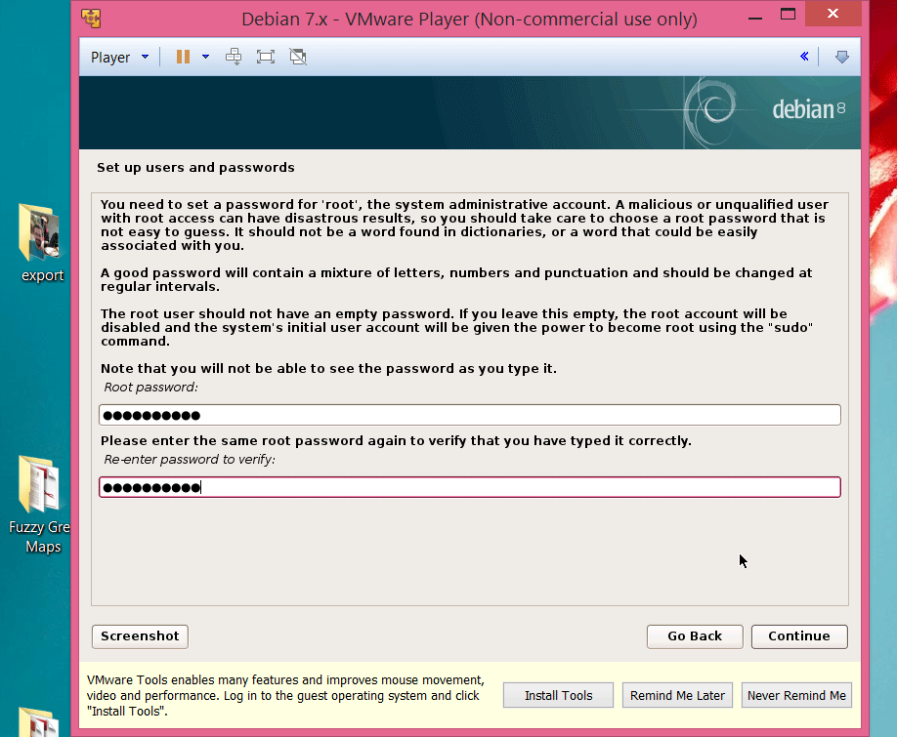
Remember when we installed the distribution... We set a root password, and a user password.
23
A crash intro: the shell, permissions and files

Slide 24

Permissions
also known as system administrator, and most commonly called...
root
groups
user
No restriction: can do anything!
User ID 0
Users belong to groups. A user can be in many groups.
Anybody.
Recognized by user ID
24
A crash intro: the shell, permissions and files

Slide 25
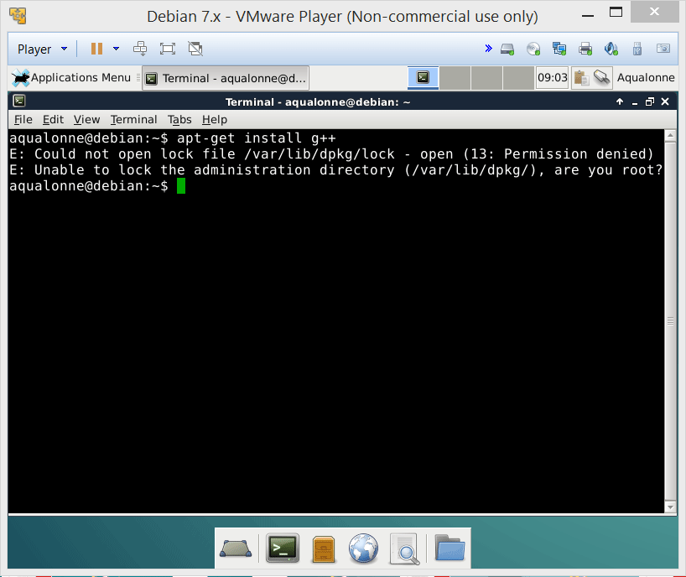
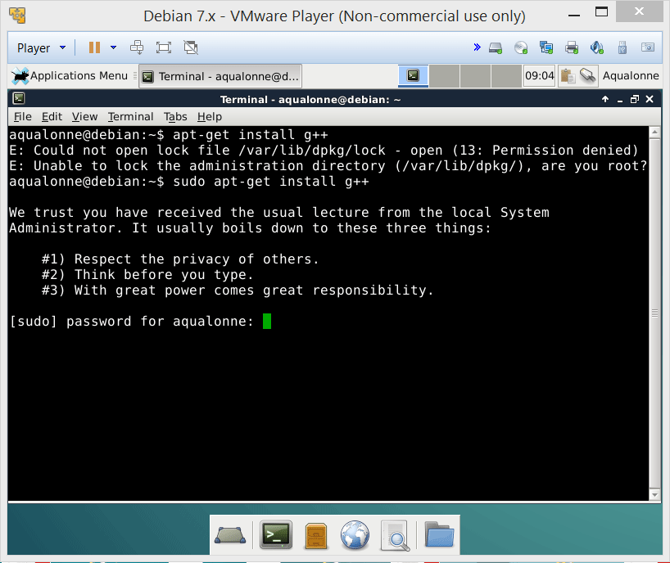
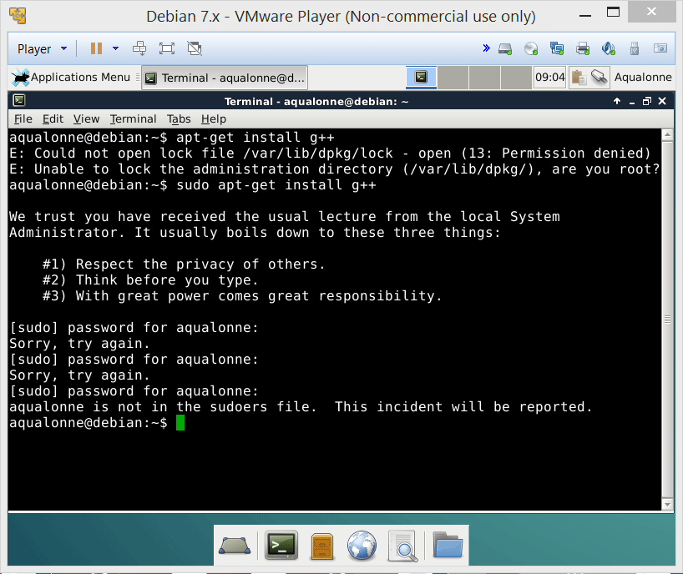

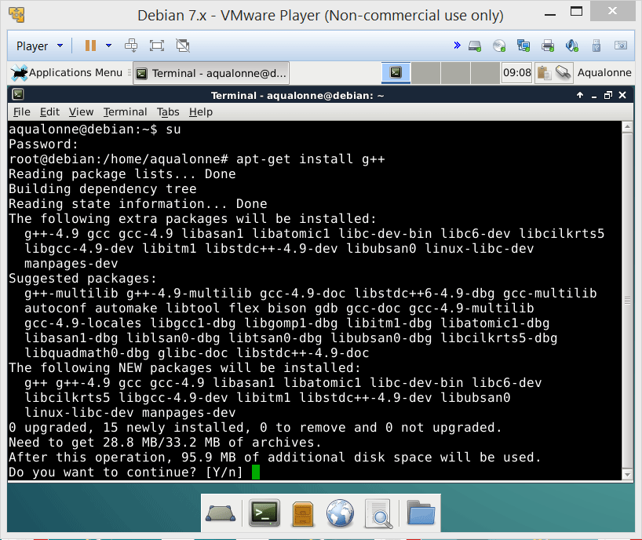
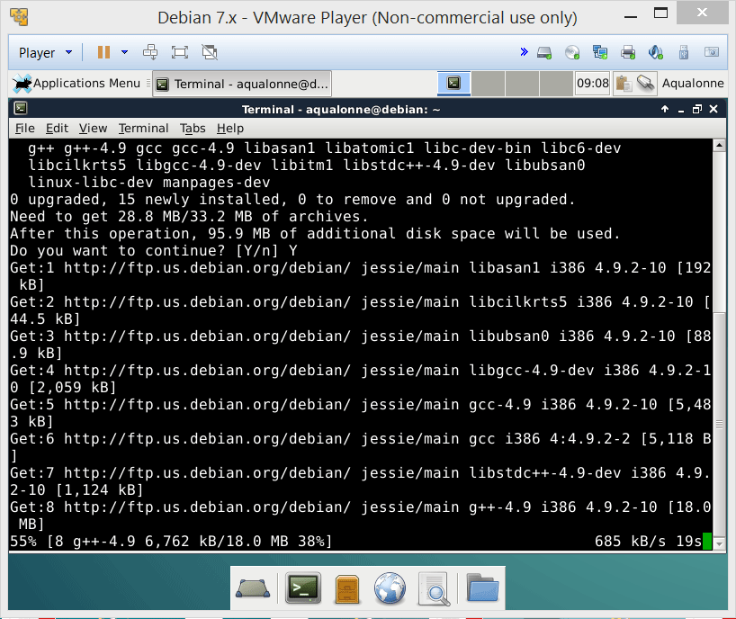
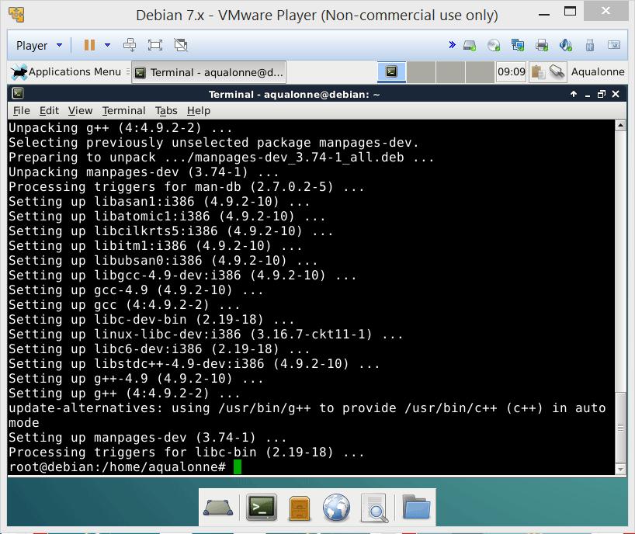
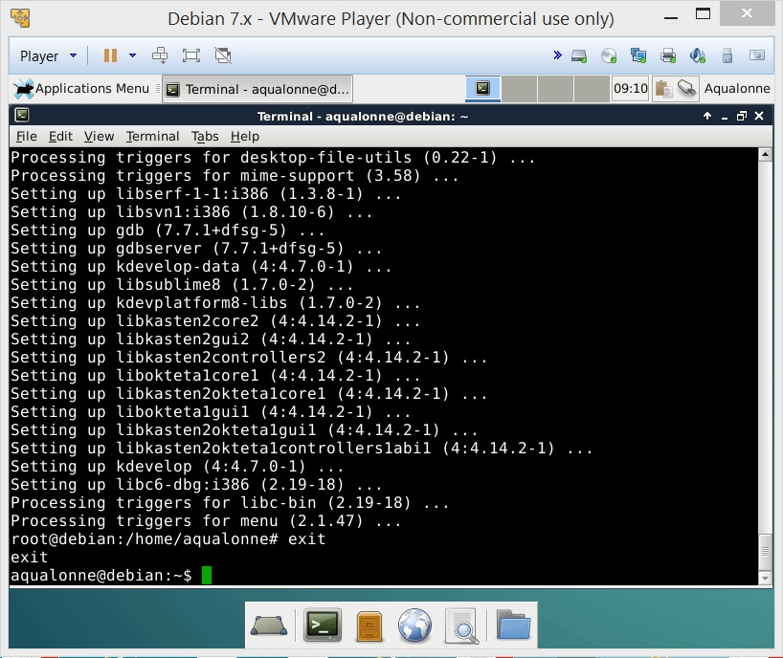
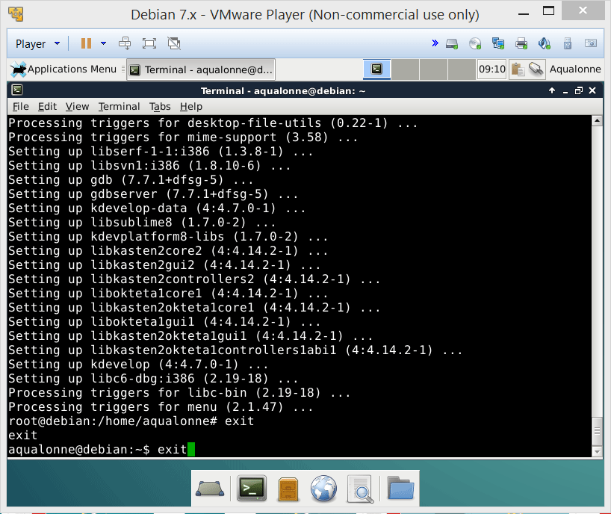
Example: trying to install software
# shows I am logged as root
$ shows I am back to normal user
25
A crash intro: the shell, permissions and files

Slide 26
Example: trying to install software
sudo command
Execute a command as root
su
Login as root. VERY, VERY RISKY!
apt-get install
Install a program
Logoff. If logged on multiple names, you’ll go back to your previous id.
exit
26
A crash intro: the shell, permissions and files

Slide 27
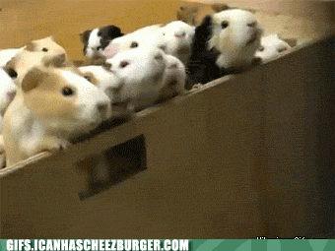
DO NOT give root access to many users.
That’d be risky, uncontrollable, irresponsible.
Should you nonetheless feel like you want to gamble with your life as a sys admin, at least log what the users do (e.g., using https://github.com/a2o/snoopy)
27
A crash intro: the shell, permissions and files

Slide 28

Practice at home: installing software as root
Install KDevelop and g++ using the following commands:
$ su
# apt-get install g++
# apt-get install kdevelop
# exit
This will give you a C++ compiler (named g++) and an IDE (named KDevelop).
You will need the compiler for your assignments, but you can write your files with anything you like (= you don’t have to use KDevelop if you prefer something else).
28
A crash intro: the shell, permissions and files

Slide 29
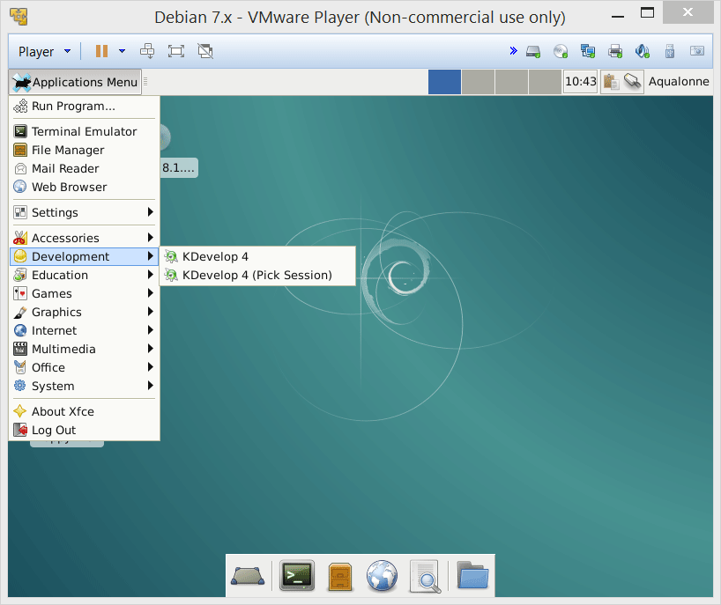
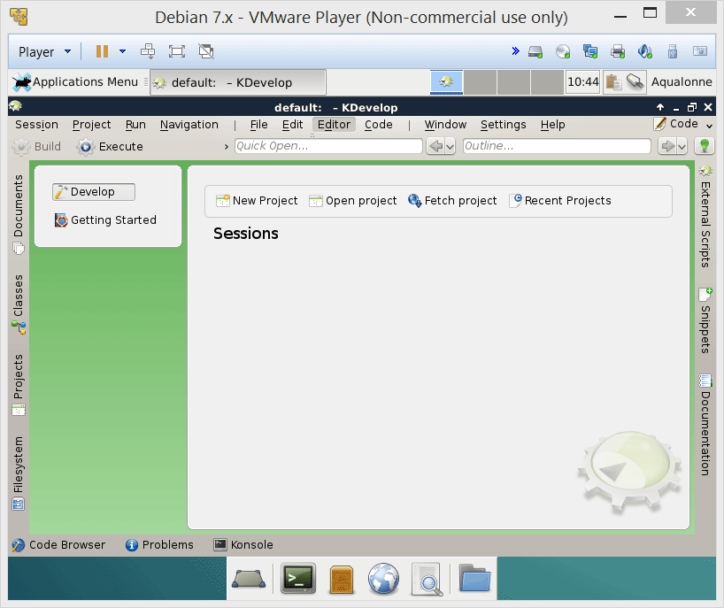
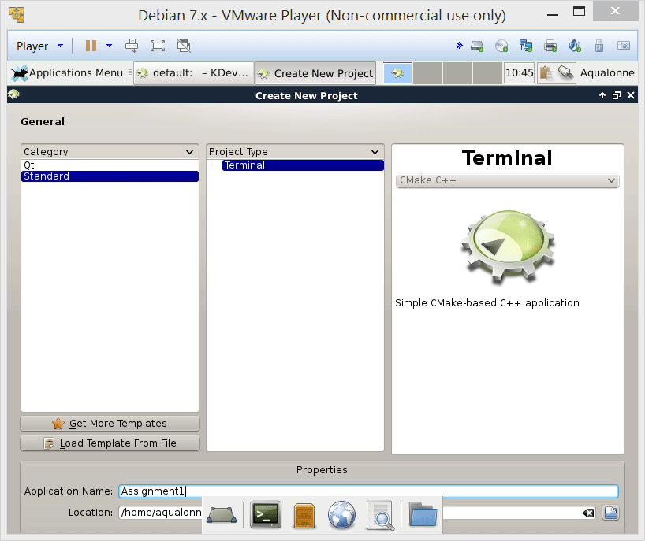
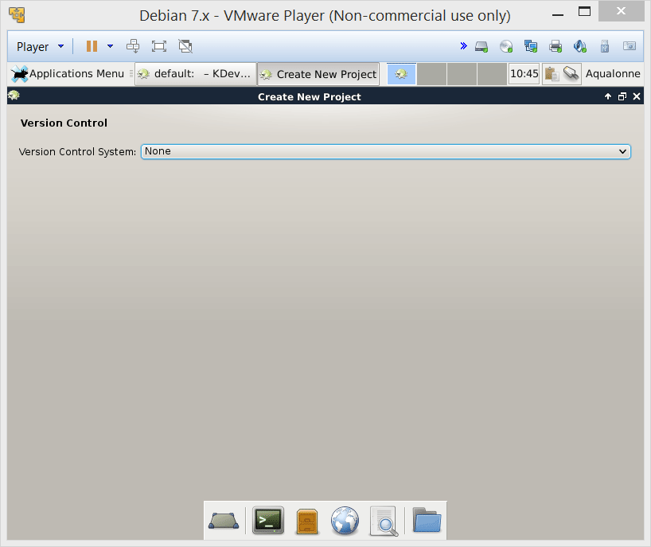
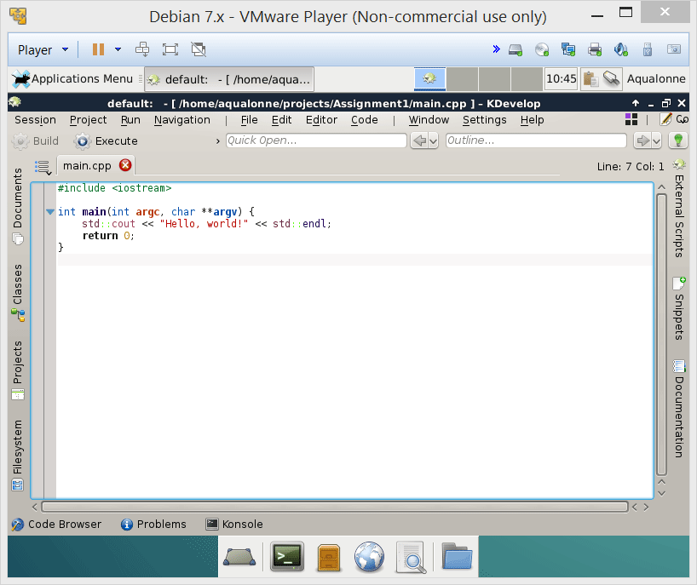
Practice at home: installing software as root
This will be what you get after you do the install at home.
29
A crash intro: the shell, permissions and files

